Slide 1
The Maximum-subarray Problem

Slide 2
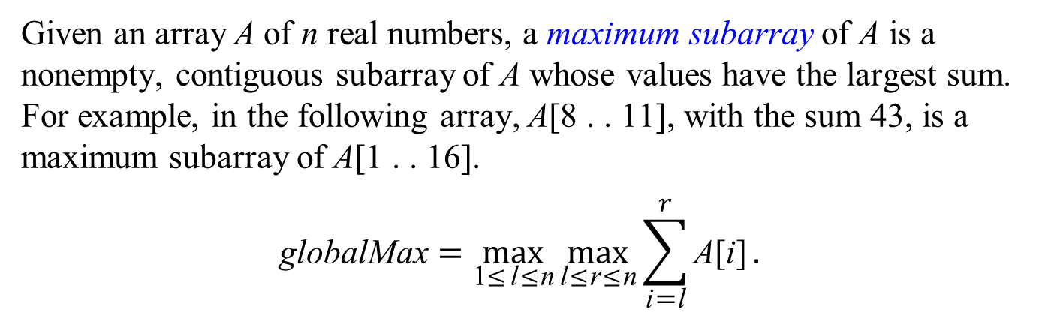
The Maximum-subarray Problem
Given an array A of n real numbers, a maximum subarray of A is a nonempty, contiguous subarray of A whose values have the largest sum. For example, in the following array, A[8 . . 11], with the sum 43, is a maximum subarray of A[1 . . 16].
$$\text{globalMax}=\max_{\text{1}\text{≤}\text{l}\text{≤}\text{n}}{\max_{\text{l}\text{≤}\text{r}\text{≤}\text{n}}{\sum_{\text{i}\text{=}\text{l}}^{r}{\text{A}\text{[}\text{i}\text{]}}}}.$$
 |  |  |  |  |  |  | l |  |  | r
1 | 2 | 3 | 4 | 5 | 6 | 7 | 8 | 9 | 10 | 11 | 12 | 13 | 14 | 15 | 16
13 | −3 | −25 | 20 | −3 | −16 | −23 | 18 | 20 | −7 | 12 | −5 | −22 | −15 | −4 | 7

Slide 3
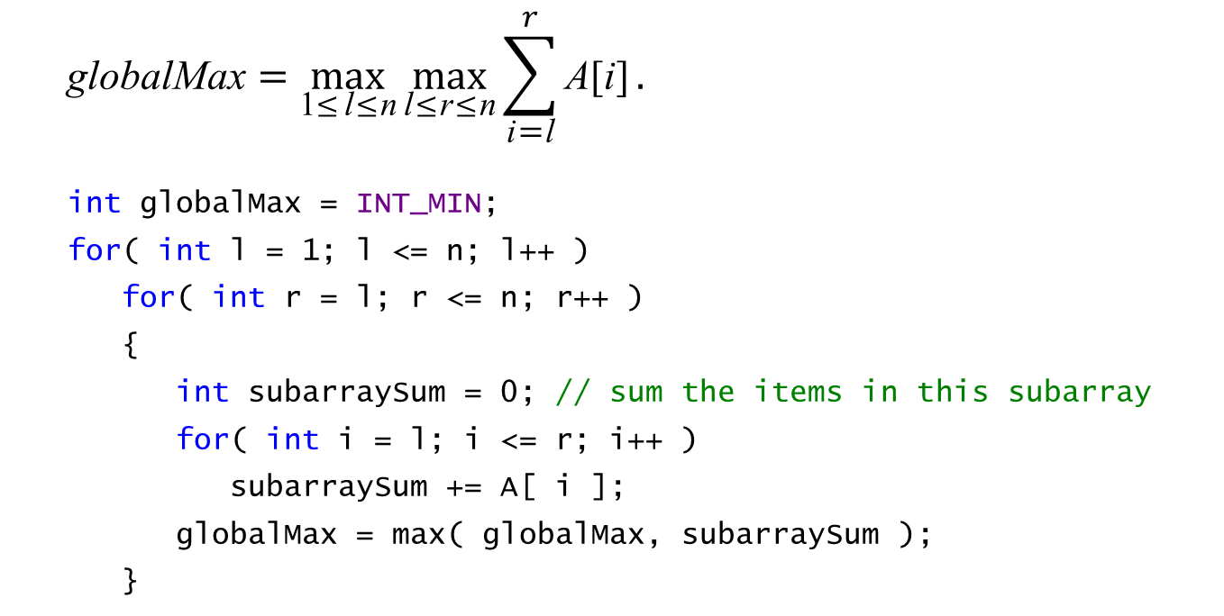
A Complete Search Algorithm
$$\text{globalM}\text{ax}=\max_{\text{1}\text{≤}\text{l}\text{≤}\text{n}}{\max_{\text{l}\text{≤}\text{r}\text{≤}\text{n}}{\sum_{\text{i}\text{=}\text{l}}^{r}{\text{A}\text{[}\text{i}\text{]}}}}.$$
int globalMax = INT_MIN;
for( int l = 1; l <= n; l++ )
for( int r = l; r <= n; r++ )
{
int subarraySum = 0; // sum the items in this subarray
for( int i = l; i <= r; i++ )
subarraySum += A[ i ];
globalMax = max( globalMax, subarraySum );
}
 |  |  |  |  |  |  | l |  |  | r
1 | 2 | 3 | 4 | 5 | 6 | 7 | 8 | 9 | 10 | 11 | 12 | 13 | 14 | 15 | 16
13 | −3 | −25 | 20 | −3 | −16 | −23 | 18 | 20 | −7 | 12 | −5 | −22 | −15 | −4 | 7

Slide 4

An Exhaustive Search Algorithm
$$\text{globalM}\text{ax}=\max_{\text{1}\text{≤}\text{r}\text{≤}\text{n}}{\max_{\text{1}\text{≤}\text{l}\text{≤}\text{r}}{\sum_{\text{i}\text{=}\text{l}}^{r}{\text{A}\text{[}\text{i}\text{]}}}}.$$
int globalMax = INT_MIN;
for( int r = 1; r <= n; r++ )
for( int l = 1; l <= r; l++ )
{
int subarraySum = 0; // sum the items in this subarray
for( int i = l; i <= r; i++ )
subarraySum += A[ i ];
globalMax = max( globalMax, subarraySum );
}
 |  |  |  |  |  |  | l |  |  | r
1 | 2 | 3 | 4 | 5 | 6 | 7 | 8 | 9 | 10 | 11 | 12 | 13 | 14 | 15 | 16
13 | −3 | −25 | 20 | −3 | −16 | −23 | 18 | 20 | −7 | 12 | −5 | −22 | −15 | −4 | 7

Slide 5
An n² Algorithm

Slide 6

$$\text{sum}\left[\text{i}\right]=\sum_{\text{j}\text{=}\text{1}}^{\text{i}}{\text{A}\text{[} \text{j}\text{]}}.$$
$$\text{globalMax}=\max_{\text{1}\text{≤}\text{r}\text{≤}\text{n}}{\max_{\text{1}\text{≤}\text{l}\text{≤}\text{r}}{\sum_{\text{i}\text{=}\text{l}}^{r}{\text{A}\text{[}\text{i}\text{]}}}}=\max_{\text{1}\text{≤}\text{r}\text{≤}\text{n}}{\max_{\text{1}\text{≤}\text{l}\text{≤}\text{r}}{(\text{sum}\left[\text{r}\right]−\text{sum}\text{[}\text{l}−\text{1]})}}.$$
 |  |  |  |  |  |  | l |  |  | r
1 | 2 | 3 | 4 | 5 | 6 | 7 | 8 | 9 | 10 | 11 | 12 | 13 | 14 | 15 | 16
13 | −3 | −25 | 20 | −3 | −16 | −23 | 18 | 20 | −7 | 12 | −5 | −22 | −15 | −4 | 7

Slide 7
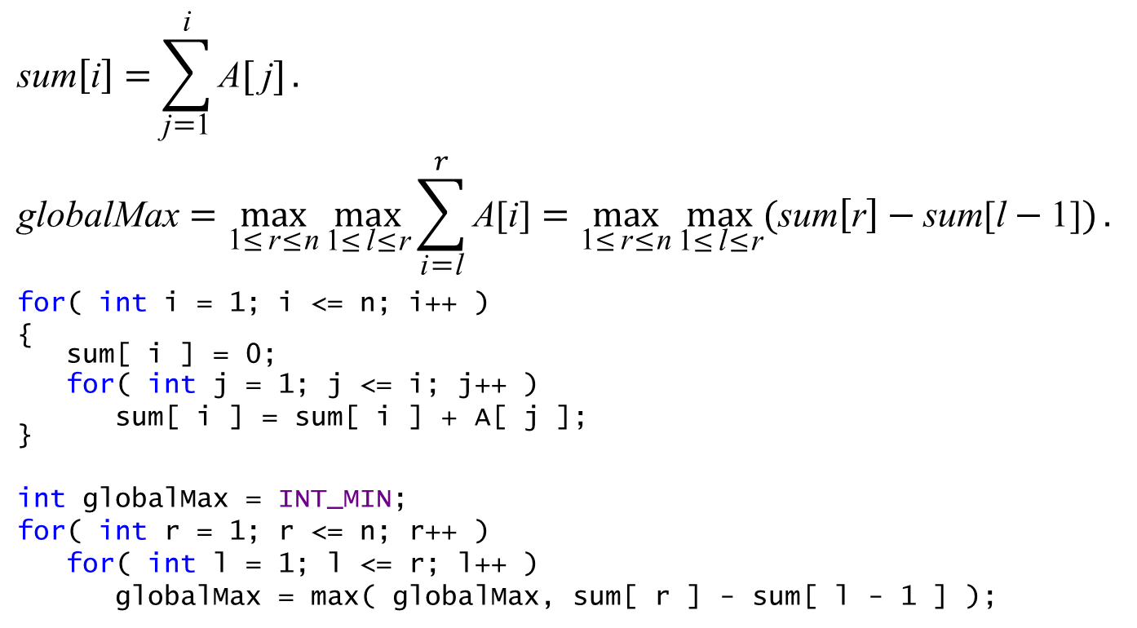
$$\text{sum}\left[\text{i}\right]=\sum_{\text{j}\text{=}\text{1}}^{\text{i}}{\text{A}\text{[} \text{j}\text{]}}.$$
$$\text{globalMax}=\max_{\text{1}\text{≤}\text{r}\text{≤}\text{n}}{\max_{\text{1}\text{≤}\text{l}\text{≤}\text{r}}{\sum_{\text{i}\text{=}\text{l}}^{r}{\text{A}\text{[}\text{i}\text{]}}}}=\max_{\text{1}\text{≤}\text{r}\text{≤}\text{n}}{\max_{\text{1}\text{≤}\text{l}\text{≤}\text{r}}{(\text{sum}\left[\text{r}\right]−\text{sum}\text{[}\text{l}−\text{1]})}}.$$
for( int i = 1; i <= n; i++ )
{
sum[ i ] = 0;
for( int j = 1; j <= i; j++ )
sum[ i ] = sum[ i ] + A[ j ];
}
int globalMax = INT_MIN;
for( int r = 1; r <= n; r++ )
for( int l = 1; l <= r; l++ )
globalMax = max( globalMax, sum[ r ] - sum[ l - 1 ] );
 |  |  |  |  |  |  | l |  |  | r
1 | 2 | 3 | 4 | 5 | 6 | 7 | 8 | 9 | 10 | 11 | 12 | 13 | 14 | 15 | 16
13 | −3 | −25 | 20 | −3 | −16 | −23 | 18 | 20 | −7 | 12 | −5 | −22 | −15 | −4 | 7

Slide 8
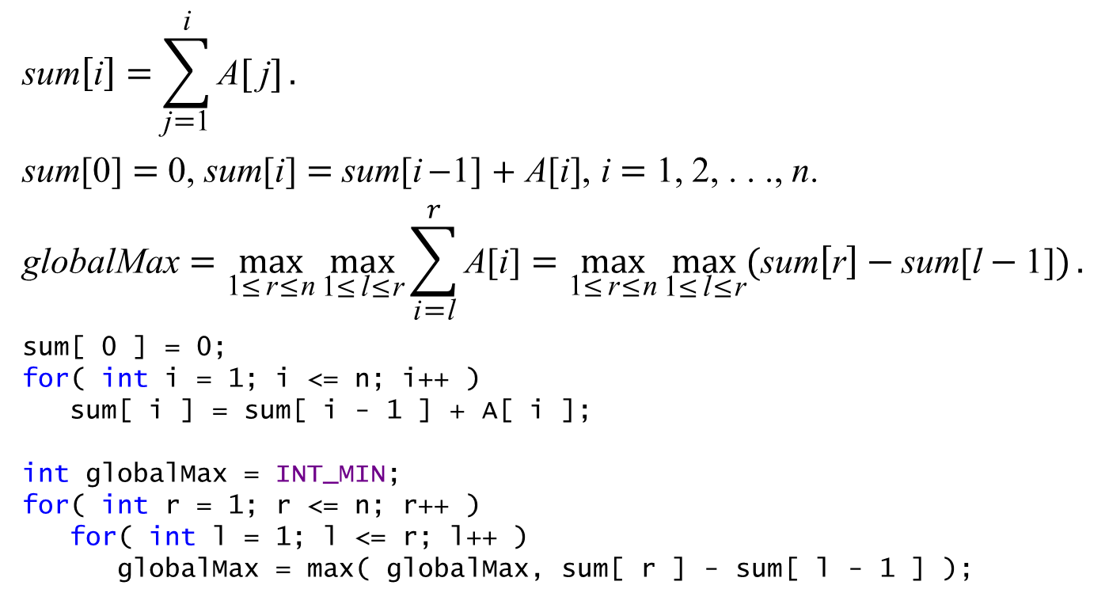
$$\text{sum}\left[\text{i}\right]=\sum_{\text{j}\text{=}\text{1}}^{\text{i}}{\text{A}\text{[} \text{j}\text{]}}.$$
sum[0] = 0, sum[i] = sum[i−1] + A[i], i = 1, 2, . . ., n.
$$\text{globalMax}=\max_{\text{1}\text{≤}\text{r}\text{≤}\text{n}}{\max_{\text{1}\text{≤}\text{l}\text{≤}\text{r}}{\sum_{\text{i}\text{=}\text{l}}^{r}{\text{A}\text{[}\text{i}\text{]}}}}=\max_{\text{1}\text{≤}\text{r}\text{≤}\text{n}}{\max_{\text{1}\text{≤}\text{l}\text{≤}\text{r}}{(\text{sum}\left[\text{r}\right]−\text{sum}\text{[}\text{l}−\text{1]})}}.$$
sum[ 0 ] = 0;
for( int i = 1; i <= n; i++ )
sum[ i ] = sum[ i - 1 ] + A[ i ];
int globalMax = INT_MIN;
for( int r = 1; r <= n; r++ )
for( int l = 1; l <= r; l++ )
globalMax = max( globalMax, sum[ r ] - sum[ l - 1 ] );
 |  |  |  |  |  |  | l |  |  | r
1 | 2 | 3 | 4 | 5 | 6 | 7 | 8 | 9 | 10 | 11 | 12 | 13 | 14 | 15 | 16
13 | −3 | −25 | 20 | −3 | −16 | −23 | 18 | 20 | −7 | 12 | −5 | −22 | −15 | −4 | 7

Slide 9
Comparison
int globalMax = INT_MIN;
for( int r = 1; r <= n; r++ )
for( int l = 1; l <= r; l++ )
{
int subarraySum = 0; // sum the items in this subarray
for( int i = l; i <= r; i++ )
subarraySum += A[ i ];
globalMax = max( globalMax, subarraySum );
}
int globalMax = INT_MIN;
for( int r = 1; r <= n; r++ )
for( int l = 1; l <= r; l++ )
{
int subarraySum = sum[ r ] - sum[ l - 1 ];
globalMax = max( globalMax, subarraySum );
}

Slide 11

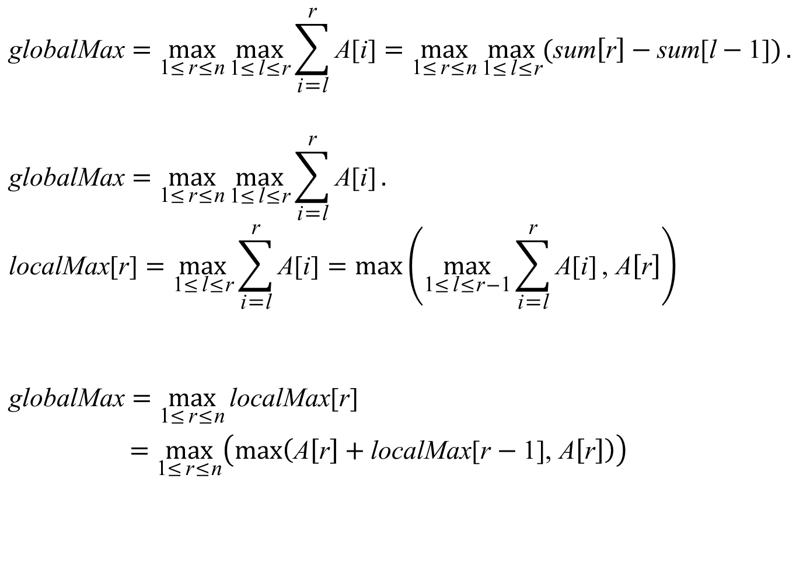
$$\text{globalMax}=\max_{\text{1}\text{≤}\text{r}\text{≤}\text{n}}{\max_{\text{1}\text{≤}\text{l}\text{≤}\text{r}}{\sum_{\text{i}\text{=}\text{l}}^{\text{r}}{\text{A}\text{[}\text{i}\text{]}}}}=\max_{\text{1}\text{≤}\text{r}\text{≤}\text{n}}{\max_{\text{1}\text{≤}\text{l}\text{≤}\text{r}}{(\text{sum}\left[\text{r}\right]−\text{sum}\text{[}\text{l}−\text{1]})}}.$$
$$\text{globalM}\text{ax}=\max_{\text{1}\text{≤}\text{r}\text{≤}\text{n}}{\max_{\text{1}\text{≤}\text{l}\text{≤}\text{r}}{\sum_{\text{i}\text{=}\text{l}}^{\text{r}}{\text{A}\text{[}\text{i}\text{]}}}}.$$
$$\text{localMax}\text{[}\text{r}\text{]}=\max_{\text{1}\text{≤}\text{l}\text{≤}\text{r}}{\sum_{\text{i}\text{=}\text{l}}^{\text{r}}{\text{A}\text{[}\text{i}\text{]}}}=max⁡\left(\max_{\text{1}\text{≤}\text{l}\text{≤}\text{r}\text{−}\text{1}}{\sum_{\text{i}\text{=}\text{l}}^{\text{r}}{\text{A}\text{[}\text{i}\text{]}}}\text{,} \text{A}\left[\text{r}\right]\right)$$
$$\text{globalMax}=\max_{\text{1}\text{≤}\text{r}\text{≤}\text{n}}{\text{localMax}\text{[}\text{r}\text{]}}$$
$$=\max_{\text{1}\text{≤}\text{r}\text{≤}\text{n}}\left(\text{max}\left(\text{A}\left[\text{r}\right]+\text{localMax}\text{[}\text{r}−\text{1]}\text{,} \text{A}\left[\text{r}\right]\right)\right)$$
$$\text{localMax}\text{[}\text{r}−\text{1]}=\max_{\text{1}\text{≤}\text{l}\text{≤}\text{r}\text{−}\text{1}}{\sum_{\text{i}\text{=}\text{l}}^{\text{r}\text{−}\text{1}}{\text{A}\text{[}\text{i}\text{]}}}$$

Slide 13
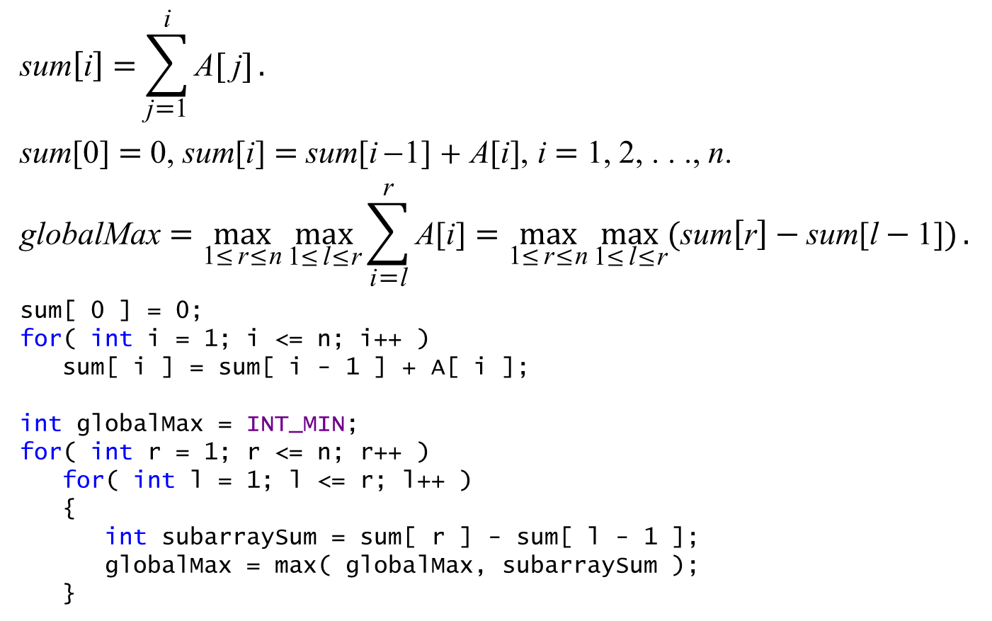
A Solution Using Dynamic Programming
$$\text{sum}\left[\text{i}\right]=\sum_{\text{j}\text{=}\text{1}}^{\text{i}}{\text{A}\text{[} \text{j}\text{]}}.$$
sum[0] = 0, sum[i] = sum[i−1] + A[i], i = 1, 2, . . ., n.
$$\text{globalMax}=\max_{\text{1}\text{≤}\text{r}\text{≤}\text{n}}{\max_{\text{1}\text{≤}\text{l}\text{≤}\text{r}}{\sum_{\text{i}\text{=}\text{l}}^{\text{r}}{\text{A}\text{[}\text{i}\text{]}}}}=\max_{\text{1}\text{≤}\text{r}\text{≤}\text{n}}{\max_{\text{1}\text{≤}\text{l}\text{≤}\text{r}}{(\text{sum}\left[\text{r}\right]−\text{sum}\text{[}\text{l}−\text{1]})}}.$$
sum[ 0 ] = 0;
for( int i = 1; i <= n; i++ )
sum[ i ] = sum[ i - 1 ] + A[ i ];
int globalMax = INT_MIN;
for( int r = 1; r <= n; r++ )
for( int l = 1; l <= r; l++ )
{
int subarraySum = sum[ r ] - sum[ l - 1 ];
globalMax = max( globalMax, subarraySum );
}

Slide 14


$$\text{globalM}\text{ax}=\max_{\text{1}\text{≤}\text{r}\text{≤}\text{n}}{\max_{\text{1}\text{≤}\text{l}\text{≤}\text{r}}{\sum_{\text{i}\text{=}\text{l}}^{\text{r}}{\text{A}\text{[}\text{i}\text{]}}}}.$$
$$\text{localMax}\text{[}\text{r}\text{]}=\max_{\text{1}\text{≤}\text{l}\text{≤}\text{r}}{\sum_{\text{i}\text{=}\text{l}}^{\text{r}}{\text{A}\text{[}\text{i}\text{]}}}=max⁡\left(\max_{\text{1}\text{≤}\text{l}\text{≤}\text{r}\text{−}\text{1}}{\sum_{\text{i}\text{=}\text{l}}^{\text{r}}{\text{A}\text{[}\text{i}\text{]}}}\text{,} \text{A}\left[\text{r}\right]\right)$$
$$=\text{max}\left(\max_{\text{1}\text{≤}\text{l}\text{≤}\text{r}\text{−}\text{1}}{(\text{A}\left[\text{r}\right]+\sum_{\text{i}\text{=}\text{l}}^{\text{r}\text{−}\text{1}}{\text{A}\text{[}\text{i}\text{]}})}\text{,} \text{A}\left[\text{r}\right]\right)$$
$$=\text{max}\left(\text{A}\left[\text{r}\right]+\max_{\text{1}\text{≤}\text{l}\text{≤}\text{r}\text{−}\text{1}}{\sum_{\text{i}\text{=}\text{l}}^{\text{r}\text{−}\text{1}}{\text{A}\text{[}\text{i}\text{]}}}\text{,} \text{A}\left[\text{r}\right]\right)$$
$$=\text{max}\left(\text{A}\left[\text{r}\right]+\text{localMax}\text{[}\text{r}−\text{1]}\text{,} \text{A}\left[\text{r}\right]\right)$$
$$\text{globalMax}=\max_{\text{1}\text{≤}\text{r}\text{≤}\text{n}}{\text{localMax}\text{[}\text{r}\text{]}}$$
$$=\max_{\text{1}\text{≤}\text{r}\text{≤}\text{n}}\left(\text{max}\left(\text{A}\left[\text{r}\right]+\text{localMax}\text{[}\text{r}−\text{1]}\text{,} \text{A}\left[\text{r}\right]\right)\right)$$
$$\text{localMax}\text{[}\text{r}−\text{1]}=\max_{\text{1}\text{≤}\text{l}\text{≤}\text{r}\text{−}\text{1}}{\sum_{\text{i}\text{=}\text{l}}^{\text{r}\text{−}\text{1}}{\text{A}\text{[}\text{i}\text{]}}}$$

Slide 15

$$\text{globalM}\text{ax}=\max_{\text{1}\text{≤}\text{r}\text{≤}\text{n}}{\max_{\text{1}\text{≤}\text{l}\text{≤}\text{r}}{\sum_{\text{i}\text{=}\text{l}}^{\text{r}}{\text{A}\text{[}\text{i}\text{]}}}}.$$
$$\text{localMax}\text{[}\text{r}\text{]}=\max_{\text{1}\text{≤}\text{l}\text{≤}\text{r}}{\sum_{\text{i}\text{=}\text{l}}^{\text{r}}{\text{A}\text{[}\text{i}\text{]}}}=max⁡\left(\max_{\text{1}\text{≤}\text{l}\text{≤}\text{r}\text{−}\text{1}}{\sum_{\text{i}\text{=}\text{l}}^{\text{r}}{\text{A}\text{[}\text{i}\text{]}}}\text{,} \text{A}\left[\text{r}\right]\right)$$
$$=\text{max}\left(\max_{\text{1}\text{≤}\text{l}\text{≤}\text{r}\text{−}\text{1}}{(\text{A}\left[\text{r}\right]+\sum_{\text{i}\text{=}\text{l}}^{\text{r}\text{−}\text{1}}{\text{A}\text{[}\text{i}\text{]}})}\text{,} \text{A}\left[\text{r}\right]\right)$$
$$=\text{max}\left(\text{A}\left[\text{r}\right]+\max_{\text{1}\text{≤}\text{l}\text{≤}\text{r}\text{−}\text{1}}{\sum_{\text{i}\text{=}\text{l}}^{\text{r}\text{−}\text{1}}{\text{A}\text{[}\text{i}\text{]}}}\text{,} \text{A}\left[\text{r}\right]\right)$$
$$=\text{max}\left(\text{A}\left[\text{r}\right]+\text{localMax}\text{[}\text{r}−\text{1]}\text{,} \text{A}\left[\text{r}\right]\right)$$
$$\text{globalMax}=\max_{\text{1}\text{≤}\text{r}\text{≤}\text{n}}{\text{localMax}\text{[}\text{r}\text{]}}$$
$$=\max_{\text{1}\text{≤}\text{r}\text{≤}\text{n}}\left(\text{max}\left(\text{A}\left[\text{r}\right]+\text{localMax}\text{[}\text{r}−\text{1]}\text{,} \text{A}\left[\text{r}\right]\right)\right)$$
$$\text{localMax}\text{[}\text{r}−\text{1]}=\max_{\text{1}\text{≤}\text{l}\text{≤}\text{r}\text{−}\text{1}}{\sum_{\text{i}\text{=}\text{l}}^{\text{r}\text{−}\text{1}}{\text{A}\text{[}\text{i}\text{]}}}$$

Slide 16
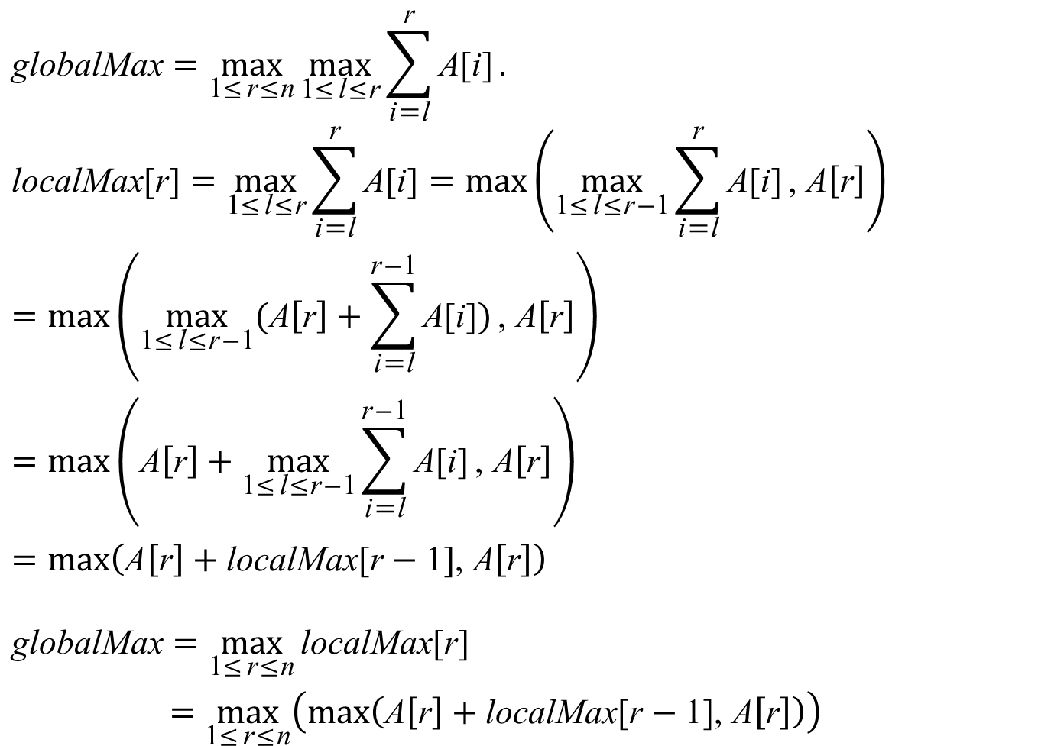
$$\text{globalM}\text{ax}=\max_{\text{1}\text{≤}\text{r}\text{≤}\text{n}}{\max_{\text{1}\text{≤}\text{l}\text{≤}\text{r}}{\sum_{\text{i}\text{=}\text{l}}^{\text{r}}{\text{A}\text{[}\text{i}\text{]}}}}.$$
$$\text{localMax}\text{[}\text{r}\text{]}=\max_{\text{1}\text{≤}\text{l}\text{≤}\text{r}}{\sum_{\text{i}\text{=}\text{l}}^{\text{r}}{\text{A}\text{[}\text{i}\text{]}}}=max⁡\left(\max_{\text{1}\text{≤}\text{l}\text{≤}\text{r}\text{−}\text{1}}{\sum_{\text{i}\text{=}\text{l}}^{\text{r}}{\text{A}\text{[}\text{i}\text{]}}}\text{,} \text{A}\left[\text{r}\right]\right)$$
$$=\text{max}\left(\max_{\text{1}\text{≤}\text{l}\text{≤}\text{r}\text{−}\text{1}}{(\text{A}\left[\text{r}\right]+\sum_{\text{i}\text{=}\text{l}}^{\text{r}\text{−}\text{1}}{\text{A}\text{[}\text{i}\text{]}})}\text{,} \text{A}\left[\text{r}\right]\right)$$
$$=\text{max}\left(\text{A}\left[\text{r}\right]+\max_{\text{1}\text{≤}\text{l}\text{≤}\text{r}\text{−}\text{1}}{\sum_{\text{i}\text{=}\text{l}}^{\text{r}\text{−}\text{1}}{\text{A}\text{[}\text{i}\text{]}}}\text{,} \text{A}\left[\text{r}\right]\right)$$
$$=\text{max}\left(\text{A}\left[\text{r}\right]+\text{localMax}\text{[}\text{r}−\text{1]}\text{,} \text{A}\left[\text{r}\right]\right)$$
$$\text{globalMax}=\max_{\text{1}\text{≤}\text{r}\text{≤}\text{n}}{\text{localMax}\text{[}\text{r}\text{]}}$$
$$=\max_{\text{1}\text{≤}\text{r}\text{≤}\text{n}}\left(\text{max}\left(\text{A}\left[\text{r}\right]+\text{localMax}\text{[}\text{r}−\text{1]}\text{,} \text{A}\left[\text{r}\right]\right)\right)$$
$$\text{localMax}\text{[}\text{r}−\text{1]}=\max_{\text{1}\text{≤}\text{l}\text{≤}\text{r}\text{−}\text{1}}{\sum_{\text{i}\text{=}\text{l}}^{\text{r}\text{−}\text{1}}{\text{A}\text{[}\text{i}\text{]}}}$$

Slide 17

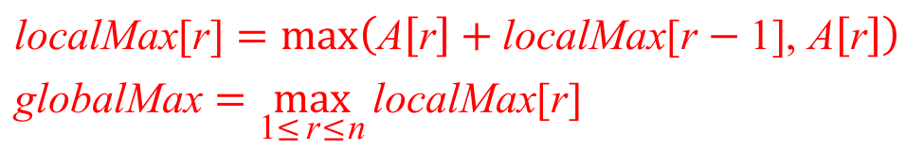

A Solution Using Dynamic Programming
int maxSubarray( int low, int high )
{
int localMax[ n + 1 ];
localMax[ low ] = A[ low ];
for( int i = low + 1; i <= high; i++ )
localMax[ i ] = max( A[ i ], localMax[ i - 1 ] + A[ i ] );
int globalMax = A[ low ];
for( int i = low + 1; i <= high; i++ )
if( globalMax < localMax[ i ] )
globalMax = localMax[ i ];
return globalMax;
}
$$\text{localMax}\text{[}\text{1}\text{]}=\max_{\text{1}\text{≤}\text{l}\text{≤}\text{1}}{\sum_{\text{i}\text{=}\text{l}}^{\text{1}}{\text{A}\text{[}\text{i}\text{]}}}=\text{A}\text{[1]}$$
$$\text{localMax}\text{[}\text{r}\text{]}=\max_{\text{1}\text{≤}\text{l}\text{≤}\text{r}}{\sum_{\text{i}\text{=}\text{l}}^{r}{\text{A}\text{[}\text{i}\text{]}}}$$
$$\text{localMax}\text{[}\text{r}\text{]}=\text{max}\left(\text{A}\left[\text{r}\right]+\text{localMax}\text{[}\text{r}−\text{1]}\text{,} \text{A}\left[\text{r}\right]\right)$$
$$\text{globalMax}=\max_{\text{1}\text{≤}\text{r}\text{≤}\text{n}}{\text{localMax}\text{[}\text{r}\text{]}}$$

Slide 18
A Solution Using Dynamic Programming
1 | 2 | 3 | 4 | 5 | 6 | 7 | 8 | 9 | 10 | 11 | 12 | 13 | 14 | 15 | 16
13 | −3 | −25 | 20 | −3 | −16 | −23 | 18 | 20 | −7 | 12 | −5 | −22 | −15 | −4 | 7
int maxSubarray( int low, int high )
{
int localMax[ n + 1 ];
localMax[ low ] = A[ low ];
for( int i = low + 1; i <= high; i++ )
localMax[ i ] = max( A[ i ], localMax[ i - 1 ] + A[ i ] );
int globalMax = A[ low ];
for( int i = low + 1; i <= high; i++ )
if( globalMax < localMax[ i ] )
globalMax = localMax[ i ];
return globalMax;
}
globalMax

Slide 19
A Solution Using Dynamic Programming
1 | 2 | 3 | 4 | 5 | 6 | 7 | 8 | 9 | 10 | 11 | 12 | 13 | 14 | 15 | 16
13 | −3 | −25 | 20 | −3 | −16 | −23 | 18 | 20 | −7 | 12 | −5 | −22 | −15 | −4 | 7
13
int maxSubarray( int low, int high )
{
int localMax[ n + 1 ];
localMax[ low ] = A[ low ];
for( int i = low + 1; i <= high; i++ )
localMax[ i ] = max( A[ i ], localMax[ i - 1 ] + A[ i ] );
int globalMax = A[ low ];
for( int i = low + 1; i <= high; i++ )
if( globalMax < localMax[ i ] )
globalMax = localMax[ i ];
return globalMax;
}
globalMax

Slide 20
A Solution Using Dynamic Programming
1 | 2 | 3 | 4 | 5 | 6 | 7 | 8 | 9 | 10 | 11 | 12 | 13 | 14 | 15 | 16
13 | −3 | −25 | 20 | −3 | −16 | −23 | 18 | 20 | −7 | 12 | −5 | −22 | −15 | −4 | 7
13 | 10
int maxSubarray( int low, int high )
{
int localMax[ n + 1 ];
localMax[ low ] = A[ low ];
for( int i = low + 1; i <= high; i++ )
localMax[ i ] = max( A[ i ], localMax[ i - 1 ] + A[ i ] );
int globalMax = A[ low ];
for( int i = low + 1; i <= high; i++ )
if( globalMax < localMax[ i ] )
globalMax = localMax[ i ];
return globalMax;
}
globalMax

Slide 21
A Solution Using Dynamic Programming
1 | 2 | 3 | 4 | 5 | 6 | 7 | 8 | 9 | 10 | 11 | 12 | 13 | 14 | 15 | 16
13 | −3 | −25 | 20 | −3 | −16 | −23 | 18 | 20 | −7 | 12 | −5 | −22 | −15 | −4 | 7
13 | 10 | −15
int maxSubarray( int low, int high )
{
int localMax[ n + 1 ];
localMax[ low ] = A[ low ];
for( int i = low + 1; i <= high; i++ )
localMax[ i ] = max( A[ i ], localMax[ i - 1 ] + A[ i ] );
int globalMax = A[ low ];
for( int i = low + 1; i <= high; i++ )
if( globalMax < localMax[ i ] )
globalMax = localMax[ i ];
return globalMax;
}
globalMax

Slide 22
A Solution Using Dynamic Programming
1 | 2 | 3 | 4 | 5 | 6 | 7 | 8 | 9 | 10 | 11 | 12 | 13 | 14 | 15 | 16
13 | −3 | −25 | 20 | −3 | −16 | −23 | 18 | 20 | −7 | 12 | −5 | −22 | −15 | −4 | 7
13 | 10 | −15 | 20
int maxSubarray( int low, int high )
{
int localMax[ n + 1 ];
localMax[ low ] = A[ low ];
for( int i = low + 1; i <= high; i++ )
localMax[ i ] = max( A[ i ], localMax[ i - 1 ] + A[ i ] );
int globalMax = A[ low ];
for( int i = low + 1; i <= high; i++ )
if( globalMax < localMax[ i ] )
globalMax = localMax[ i ];
return globalMax;
}
globalMax

Slide 23
A Solution Using Dynamic Programming
1 | 2 | 3 | 4 | 5 | 6 | 7 | 8 | 9 | 10 | 11 | 12 | 13 | 14 | 15 | 16
13 | −3 | −25 | 20 | −3 | −16 | −23 | 18 | 20 | −7 | 12 | −5 | −22 | −15 | −4 | 7
13 | 10 | −15 | 20 | 17
int maxSubarray( int low, int high )
{
int localMax[ n + 1 ];
localMax[ low ] = A[ low ];
for( int i = low + 1; i <= high; i++ )
localMax[ i ] = max( A[ i ], localMax[ i - 1 ] + A[ i ] );
int globalMax = A[ low ];
for( int i = low + 1; i <= high; i++ )
if( globalMax < localMax[ i ] )
globalMax = localMax[ i ];
return globalMax;
}
globalMax

Slide 24
A Solution Using Dynamic Programming
1 | 2 | 3 | 4 | 5 | 6 | 7 | 8 | 9 | 10 | 11 | 12 | 13 | 14 | 15 | 16
13 | −3 | −25 | 20 | −3 | −16 | −23 | 18 | 20 | −7 | 12 | −5 | −22 | −15 | −4 | 7
13 | 10 | −15 | 20 | 17 | 1
int maxSubarray( int low, int high )
{
int localMax[ n + 1 ];
localMax[ low ] = A[ low ];
for( int i = low + 1; i <= high; i++ )
localMax[ i ] = max( A[ i ], localMax[ i - 1 ] + A[ i ] );
int globalMax = A[ low ];
for( int i = low + 1; i <= high; i++ )
if( globalMax < localMax[ i ] )
globalMax = localMax[ i ];
return globalMax;
}
globalMax

Slide 25
A Solution Using Dynamic Programming
1 | 2 | 3 | 4 | 5 | 6 | 7 | 8 | 9 | 10 | 11 | 12 | 13 | 14 | 15 | 16
13 | −3 | −25 | 20 | −3 | −16 | −23 | 18 | 20 | −7 | 12 | −5 | −22 | −15 | −4 | 7
13 | 10 | −15 | 20 | 17 | 1 | −22
int maxSubarray( int low, int high )
{
int localMax[ n + 1 ];
localMax[ low ] = A[ low ];
for( int i = low + 1; i <= high; i++ )
localMax[ i ] = max( A[ i ], localMax[ i - 1 ] + A[ i ] );
int globalMax = A[ low ];
for( int i = low + 1; i <= high; i++ )
if( globalMax < localMax[ i ] )
globalMax = localMax[ i ];
return globalMax;
}
globalMax

Slide 26
A Solution Using Dynamic Programming
1 | 2 | 3 | 4 | 5 | 6 | 7 | 8 | 9 | 10 | 11 | 12 | 13 | 14 | 15 | 16
13 | −3 | −25 | 20 | −3 | −16 | −23 | 18 | 20 | −7 | 12 | −5 | −22 | −15 | −4 | 7
13 | 10 | −15 | 20 | 17 | 1 | −22 | 18
int maxSubarray( int low, int high )
{
int localMax[ n + 1 ];
localMax[ low ] = A[ low ];
for( int i = low + 1; i <= high; i++ )
localMax[ i ] = max( A[ i ], localMax[ i - 1 ] + A[ i ] );
int globalMax = A[ low ];
for( int i = low + 1; i <= high; i++ )
if( globalMax < localMax[ i ] )
globalMax = localMax[ i ];
return globalMax;
}
globalMax

Slide 27
A Solution Using Dynamic Programming
1 | 2 | 3 | 4 | 5 | 6 | 7 | 8 | 9 | 10 | 11 | 12 | 13 | 14 | 15 | 16
13 | −3 | −25 | 20 | −3 | −16 | −23 | 18 | 20 | −7 | 12 | −5 | −22 | −15 | −4 | 7
13 | 10 | −15 | 20 | 17 | 1 | −22 | 18 | 38
int maxSubarray( int low, int high )
{
int localMax[ n + 1 ];
localMax[ low ] = A[ low ];
for( int i = low + 1; i <= high; i++ )
localMax[ i ] = max( A[ i ], localMax[ i - 1 ] + A[ i ] );
int globalMax = A[ low ];
for( int i = low + 1; i <= high; i++ )
if( globalMax < localMax[ i ] )
globalMax = localMax[ i ];
return globalMax;
}
globalMax

Slide 28
A Solution Using Dynamic Programming
1 | 2 | 3 | 4 | 5 | 6 | 7 | 8 | 9 | 10 | 11 | 12 | 13 | 14 | 15 | 16
13 | −3 | −25 | 20 | −3 | −16 | −23 | 18 | 20 | −7 | 12 | −5 | −22 | −15 | −4 | 7
13 | 10 | −15 | 20 | 17 | 1 | −22 | 18 | 38 | 31
int maxSubarray( int low, int high )
{
int localMax[ n + 1 ];
localMax[ low ] = A[ low ];
for( int i = low + 1; i <= high; i++ )
localMax[ i ] = max( A[ i ], localMax[ i - 1 ] + A[ i ] );
int globalMax = A[ low ];
for( int i = low + 1; i <= high; i++ )
if( globalMax < localMax[ i ] )
globalMax = localMax[ i ];
return globalMax;
}
globalMax

Slide 29
A Solution Using Dynamic Programming
1 | 2 | 3 | 4 | 5 | 6 | 7 | 8 | 9 | 10 | 11 | 12 | 13 | 14 | 15 | 16
13 | −3 | −25 | 20 | −3 | −16 | −23 | 18 | 20 | −7 | 12 | −5 | −22 | −15 | −4 | 7
13 | 10 | −15 | 20 | 17 | 1 | −22 | 18 | 38 | 31 | 43
int maxSubarray( int low, int high )
{
int localMax[ n + 1 ];
localMax[ low ] = A[ low ];
for( int i = low + 1; i <= high; i++ )
localMax[ i ] = max( A[ i ], localMax[ i - 1 ] + A[ i ] );
int globalMax = A[ low ];
for( int i = low + 1; i <= high; i++ )
if( globalMax < localMax[ i ] )
globalMax = localMax[ i ];
return globalMax;
}
globalMax

Slide 30
A Solution Using Dynamic Programming
1 | 2 | 3 | 4 | 5 | 6 | 7 | 8 | 9 | 10 | 11 | 12 | 13 | 14 | 15 | 16
13 | −3 | −25 | 20 | −3 | −16 | −23 | 18 | 20 | −7 | 12 | −5 | −22 | −15 | −4 | 7
13 | 10 | −15 | 20 | 17 | 1 | −22 | 18 | 38 | 31 | 43 | 38
int maxSubarray( int low, int high )
{
int localMax[ n + 1 ];
localMax[ low ] = A[ low ];
for( int i = low + 1; i <= high; i++ )
localMax[ i ] = max( A[ i ], localMax[ i - 1 ] + A[ i ] );
int globalMax = A[ low ];
for( int i = low + 1; i <= high; i++ )
if( globalMax < localMax[ i ] )
globalMax = localMax[ i ];
return globalMax;
}
globalMax

Slide 31
A Solution Using Dynamic Programming
1 | 2 | 3 | 4 | 5 | 6 | 7 | 8 | 9 | 10 | 11 | 12 | 13 | 14 | 15 | 16
13 | −3 | −25 | 20 | −3 | −16 | −23 | 18 | 20 | −7 | 12 | −5 | −22 | −15 | −4 | 7
13 | 10 | −15 | 20 | 17 | 1 | −22 | 18 | 38 | 31 | 43 | 38 | 16
int maxSubarray( int low, int high )
{
int localMax[ n + 1 ];
localMax[ low ] = A[ low ];
for( int i = low + 1; i <= high; i++ )
localMax[ i ] = max( A[ i ], localMax[ i - 1 ] + A[ i ] );
int globalMax = A[ low ];
for( int i = low + 1; i <= high; i++ )
if( globalMax < localMax[ i ] )
globalMax = localMax[ i ];
return globalMax;
}
globalMax

Slide 32
A Solution Using Dynamic Programming
1 | 2 | 3 | 4 | 5 | 6 | 7 | 8 | 9 | 10 | 11 | 12 | 13 | 14 | 15 | 16
13 | −3 | −25 | 20 | −3 | −16 | −23 | 18 | 20 | −7 | 12 | −5 | −22 | −15 | −4 | 7
13 | 10 | −15 | 20 | 17 | 1 | −22 | 18 | 38 | 31 | 43 | 38 | 16 | 1
int maxSubarray( int low, int high )
{
int localMax[ n + 1 ];
localMax[ low ] = A[ low ];
for( int i = low + 1; i <= high; i++ )
localMax[ i ] = max( A[ i ], localMax[ i - 1 ] + A[ i ] );
int globalMax = A[ low ];
for( int i = low + 1; i <= high; i++ )
if( globalMax < localMax[ i ] )
globalMax = localMax[ i ];
return globalMax;
}
globalMax

Slide 33
A Solution Using Dynamic Programming
1 | 2 | 3 | 4 | 5 | 6 | 7 | 8 | 9 | 10 | 11 | 12 | 13 | 14 | 15 | 16
13 | −3 | −25 | 20 | −3 | −16 | −23 | 18 | 20 | −7 | 12 | −5 | −22 | −15 | −4 | 7
13 | 10 | −15 | 20 | 17 | 1 | −22 | 18 | 38 | 31 | 43 | 38 | 16 | 1 | −3
int maxSubarray( int low, int high )
{
int localMax[ n + 1 ];
localMax[ low ] = A[ low ];
for( int i = low + 1; i <= high; i++ )
localMax[ i ] = max( A[ i ], localMax[ i - 1 ] + A[ i ] );
int globalMax = A[ low ];
for( int i = low + 1; i <= high; i++ )
if( globalMax < localMax[ i ] )
globalMax = localMax[ i ];
return globalMax;
}
globalMax

Slide 34
A Solution Using Dynamic Programming
1 | 2 | 3 | 4 | 5 | 6 | 7 | 8 | 9 | 10 | 11 | 12 | 13 | 14 | 15 | 16
13 | −3 | −25 | 20 | −3 | −16 | −23 | 18 | 20 | −7 | 12 | −5 | −22 | −15 | −4 | 7
13 | 10 | −15 | 20 | 17 | 1 | −22 | 18 | 38 | 31 | 43 | 38 | 16 | 1 | −3 | 7
int maxSubarray( int low, int high )
{
int localMax[ n + 1 ];
localMax[ low ] = A[ low ];
for( int i = low + 1; i <= high; i++ )
localMax[ i ] = max( A[ i ], localMax[ i - 1 ] + A[ i ] );
int globalMax = A[ low ];
for( int i = low + 1; i <= high; i++ )
if( globalMax < localMax[ i ] )
globalMax = localMax[ i ];
return globalMax;
}
globalMax

Slide 35
A Solution Using Dynamic Programming
1 | 2 | 3 | 4 | 5 | 6 | 7 | 8 | 9 | 10 | 11 | 12 | 13 | 14 | 15 | 16
13 | −3 | −25 | 20 | −3 | −16 | −23 | 18 | 20 | −7 | 12 | −5 | −22 | −15 | −4 | 7
13 | 10 | −15 | 20 | 17 | 1 | −22 | 18 | 38 | 31 | 43 | 38 | 16 | 1 | −3 | 7
int maxSubarray( int low, int high )
{
int localMax[ n + 1 ];
localMax[ low ] = A[ low ];
for( int i = low + 1; i <= high; i++ )
localMax[ i ] = max( A[ i ], localMax[ i - 1 ] + A[ i ] );
int globalMax = A[ low ];
for( int i = low + 1; i <= high; i++ )
if( globalMax < localMax[ i ] )
globalMax = localMax[ i ];
return globalMax;
}
globalMax
43

Slide 36
A Solution Using Dynamic Programming
1 | 2 | 3 | 4 | 5 | 6 | 7 | 8 | 9 | 10 | 11 | 12 | 13 | 14 | 15 | 16
13 | −3 | −25 | 20 | −3 | −16 | −23 | 18 | 20 | −7 | 12 | −5 | −22 | −15 | −4 | 7
13 | 10 | −15 | 20 | 17 | 1 | −22 | 18 | 38 | 31 | 43 | 38 | 16 | 1 | −3 | 7
int maxSubarray( int low, int high )
{
int localMax[ n + 1 ];
localMax[ low ] = A[ low ];
int globalMax = A[ low ];
for( int i = low + 1; i <= high; i++ )
{
localMax[ i ] = max( A[ i ], localMax[ i - 1 ] + A[ i ] );
if( globalMax < localMax[ i ] )
globalMax = localMax[ i ];
}
return globalMax;
}
globalMax
43

Slide 37
A Solution Using Dynamic Programming
1 | 2 | 3 | 4 | 5 | 6 | 7 | 8 | 9 | 10 | 11 | 12 | 13 | 14 | 15 | 16
13 | −3 | −25 | 20 | −3 | −16 | −23 | 18 | 20 | −7 | 12 | −5 | −22 | −15 | −4 | 7
13 | 10 | −15 | 20 | 17 | 1 | −22 | 18 | 38 | 31 | 43 | 38 | 16 | 1 | −3 | 7
int maxSubarray( int low, int high )
{
int localMax[ n + 1 ];
localMax[ low ] = A[ low ];
int globalMax = A[ low ];
for( int i = low + 1; i <= high; i++ )
{
localMax[ i ] = max( A[ i ], localMax[ i - 1 ] + A[ i ] );
if( globalMax < localMax[ i ] )
globalMax = localMax[ i ];
}
return globalMax;
}
globalMax
43

Slide 38
A Solution Using Dynamic Programming
1 | 2 | 3 | 4 | 5 | 6 | 7 | 8 | 9 | 10 | 11 | 12 | 13 | 14 | 15 | 16
13 | −3 | −25 | 20 | −3 | −16 | −23 | 18 | 20 | −7 | 12 | −5 | −22 | −15 | −4 | 7
13 | 10 | −15 | 20 | 17 | 1 | −22 | 18 | 38 | 31 | 43 | 38 | 16 | 1 | −3 | 7
int maxSubarray( int low, int high )
{
int localMax = A[ low ];
int globalMax = A[ low ];
for( int i = low + 1; i <= high; i++ )
{
localMax = max( A[ i ], localMax + A[ i ] );
if( globalMax < localMax )
globalMax = localMax;
}
return globalMax;
}
globalMax
43

Slide 39
Kadane’s Algorithm
1 | 2 | 3 | 4 | 5 | 6 | 7 | 8 | 9 | 10 | 11 | 12 | 13 | 14 | 15 | 16
13 | −3 | −25 | 20 | −3 | −16 | −23 | 18 | 20 | −7 | 12 | −5 | −22 | −15 | −4 | 7
13 | 10 | −15 | 20 | 17 | 1 | −22 | 18 | 38 | 31 | 43 | 38 | 16 | 1 | −3 | 7
int maxSubarray( int low, int high )
{
int localMax = A[ low ];
int globalMax = A[ low ];
for( int i = low + 1; i <= high; i++ )
{
localMax = max( 0, localMax ) + A[ i ];
if( globalMax < localMax )
globalMax = localMax;
}
return globalMax;
}
globalMax
43

Slide 40
Kadane’s Algorithm
void maxSubarray( int low, int high )
{
int begin = low;
int newBegin = low;
int end = low;
int localMax = A[ low ];
int globalMax = A[ low ];
for( int newEnd = low + 1; newEnd <= high; newEnd++ )
{
localMax = max( A[ newEnd ], localMax + A[ newEnd ] );
if( globalMax < localMax )
globalMax = localMax;
if( localMax < 0 )
newBegin = newEnd + 1;
else if( localMax == globalMax )
{
begin = newBegin;
end = newEnd;
}
}
cout << globalMax << endl;
cout << begin << " " << end << endl;
}

Slide 41
void maxSubarray( int low, int high )
{
int begin = low;
int newBegin = low;
int end = low;
int localMax = A[ low ];
int globalMax = A[ low ];
for( int newEnd = low + 1; newEnd <= high; newEnd++ )
{
localMax = max( A[ newEnd ], localMax + A[ newEnd ] );
if( globalMax < localMax )
globalMax = localMax;
localMax
13
globalMax
13
1 | 2 | 3 | 4 | 5 | 6 | 7 | 8 | 9 | 10 | 11 | 12 | 13 | 14 | 15 | 16
13 | −3 | −25 | 20 | −3 | −16 | −23 | 18 | 20 | −7 | 12 | −5 | −22 | −15 | −4 | 7
1 | 2 | 3 | 4 | 5 | 6 | 7 | 8 | 9 | 10 | 11 | 12 | 13 | 14 | 15 | 16
13 | −3 | −25 | 20 | −3 | −16 | −23 | 18 | 20 | −7 | 12 | −5 | −22 | −15 | −4 | 7

Slide 42
int localMax = A[ low ];
int globalMax = A[ low ];
for( int newEnd = low + 1; newEnd <= high; newEnd++ )
{
localMax = max( A[ newEnd ], localMax + A[ newEnd ] );
if( globalMax < localMax )
globalMax = localMax;
if( localMax < 0 )
newBegin = newEnd + 1;
else if( localMax == globalMax )
{
begin = newBegin;
end = newEnd;
}
}
localMax
13
globalMax
13
1 | 2 | 3 | 4 | 5 | 6 | 7 | 8 | 9 | 10 | 11 | 12 | 13 | 14 | 15 | 16
13 | −3 | −25 | 20 | −3 | −16 | −23 | 18 | 20 | −7 | 12 | −5 | −22 | −15 | −4 | 7
1 | 2 | 3 | 4 | 5 | 6 | 7 | 8 | 9 | 10 | 11 | 12 | 13 | 14 | 15 | 16
13 | −3 | −25 | 20 | −3 | −16 | −23 | 18 | 20 | −7 | 12 | −5 | −22 | −15 | −4 | 7

Slide 43
int localMax = A[ low ];
int globalMax = A[ low ];
for( int newEnd = low + 1; newEnd <= high; newEnd++ )
{
localMax = max( A[ newEnd ], localMax + A[ newEnd ] );
if( globalMax < localMax )
globalMax = localMax;
if( localMax < 0 )
newBegin = newEnd + 1;
else if( localMax == globalMax )
{
begin = newBegin;
end = newEnd;
}
}
localMax
10
globalMax
13
1 | 2 | 3 | 4 | 5 | 6 | 7 | 8 | 9 | 10 | 11 | 12 | 13 | 14 | 15 | 16
13 | −3 | −25 | 20 | −3 | −16 | −23 | 18 | 20 | −7 | 12 | −5 | −22 | −15 | −4 | 7
1 | 2 | 3 | 4 | 5 | 6 | 7 | 8 | 9 | 10 | 11 | 12 | 13 | 14 | 15 | 16
13 | −3 | −25 | 20 | −3 | −16 | −23 | 18 | 20 | −7 | 12 | −5 | −22 | −15 | −4 | 7

Slide 44
int localMax = A[ low ];
int globalMax = A[ low ];
for( int newEnd = low + 1; newEnd <= high; newEnd++ )
{
localMax = max( A[ newEnd ], localMax + A[ newEnd ] );
if( globalMax < localMax )
globalMax = localMax;
if( localMax < 0 )
newBegin = newEnd + 1;
else if( localMax == globalMax )
{
begin = newBegin;
end = newEnd;
}
}
localMax
−15
globalMax
13
1 | 2 | 3 | 4 | 5 | 6 | 7 | 8 | 9 | 10 | 11 | 12 | 13 | 14 | 15 | 16
13 | −3 | −25 | 20 | −3 | −16 | −23 | 18 | 20 | −7 | 12 | −5 | −22 | −15 | −4 | 7
1 | 2 | 3 | 4 | 5 | 6 | 7 | 8 | 9 | 10 | 11 | 12 | 13 | 14 | 15 | 16
13 | −3 | −25 | 20 | −3 | −16 | −23 | 18 | 20 | −7 | 12 | −5 | −22 | −15 | −4 | 7

Slide 45
int localMax = A[ low ];
int globalMax = A[ low ];
for( int newEnd = low + 1; newEnd <= high; newEnd++ )
{
localMax = max( A[ newEnd ], localMax + A[ newEnd ] );
if( globalMax < localMax )
globalMax = localMax;
if( localMax < 0 )
newBegin = newEnd + 1;
else if( localMax == globalMax )
{
begin = newBegin;
end = newEnd;
}
}
localMax
−15
globalMax
13
1 | 2 | 3 | 4 | 5 | 6 | 7 | 8 | 9 | 10 | 11 | 12 | 13 | 14 | 15 | 16
13 | −3 | −25 | 20 | −3 | −16 | −23 | 18 | 20 | −7 | 12 | −5 | −22 | −15 | −4 | 7
1 | 2 | 3 | 4 | 5 | 6 | 7 | 8 | 9 | 10 | 11 | 12 | 13 | 14 | 15 | 16
13 | −3 | −25 | 20 | −3 | −16 | −23 | 18 | 20 | −7 | 12 | −5 | −22 | −15 | −4 | 7

Slide 46
int localMax = A[ low ];
int globalMax = A[ low ];
for( int newEnd = low + 1; newEnd <= high; newEnd++ )
{
localMax = max( A[ newEnd ], localMax + A[ newEnd ] );
if( globalMax < localMax )
globalMax = localMax;
if( localMax < 0 )
newBegin = newEnd + 1;
else if( localMax == globalMax )
{
begin = newBegin;
end = newEnd;
}
}
localMax
20
globalMax
20
1 | 2 | 3 | 4 | 5 | 6 | 7 | 8 | 9 | 10 | 11 | 12 | 13 | 14 | 15 | 16
13 | −3 | −25 | 20 | −3 | −16 | −23 | 18 | 20 | −7 | 12 | −5 | −22 | −15 | −4 | 7
1 | 2 | 3 | 4 | 5 | 6 | 7 | 8 | 9 | 10 | 11 | 12 | 13 | 14 | 15 | 16
13 | −3 | −25 | 20 | −3 | −16 | −23 | 18 | 20 | −7 | 12 | −5 | −22 | −15 | −4 | 7

Slide 47
int localMax = A[ low ];
int globalMax = A[ low ];
for( int newEnd = low + 1; newEnd <= high; newEnd++ )
{
localMax = max( A[ newEnd ], localMax + A[ newEnd ] );
if( globalMax < localMax )
globalMax = localMax;
if( localMax < 0 )
newBegin = newEnd + 1;
else if( localMax == globalMax )
{
begin = newBegin;
end = newEnd;
}
}
localMax
20
globalMax
20
1 | 2 | 3 | 4 | 5 | 6 | 7 | 8 | 9 | 10 | 11 | 12 | 13 | 14 | 15 | 16
13 | −3 | −25 | 20 | −3 | −16 | −23 | 18 | 20 | −7 | 12 | −5 | −22 | −15 | −4 | 7
1 | 2 | 3 | 4 | 5 | 6 | 7 | 8 | 9 | 10 | 11 | 12 | 13 | 14 | 15 | 16
13 | −3 | −25 | 20 | −3 | −16 | −23 | 18 | 20 | −7 | 12 | −5 | −22 | −15 | −4 | 7

Slide 48
int localMax = A[ low ];
int globalMax = A[ low ];
for( int newEnd = low + 1; newEnd <= high; newEnd++ )
{
localMax = max( A[ newEnd ], localMax + A[ newEnd ] );
if( globalMax < localMax )
globalMax = localMax;
if( localMax < 0 )
newBegin = newEnd + 1;
else if( localMax == globalMax )
{
begin = newBegin;
end = newEnd;
}
}
localMax
17
globalMax
20
1 | 2 | 3 | 4 | 5 | 6 | 7 | 8 | 9 | 10 | 11 | 12 | 13 | 14 | 15 | 16
13 | −3 | −25 | 20 | −3 | −16 | −23 | 18 | 20 | −7 | 12 | −5 | −22 | −15 | −4 | 7
1 | 2 | 3 | 4 | 5 | 6 | 7 | 8 | 9 | 10 | 11 | 12 | 13 | 14 | 15 | 16
13 | −3 | −25 | 20 | −3 | −16 | −23 | 18 | 20 | −7 | 12 | −5 | −22 | −15 | −4 | 7

Slide 49
int localMax = A[ low ];
int globalMax = A[ low ];
for( int newEnd = low + 1; newEnd <= high; newEnd++ )
{
localMax = max( A[ newEnd ], localMax + A[ newEnd ] );
if( globalMax < localMax )
globalMax = localMax;
if( localMax < 0 )
newBegin = newEnd + 1;
else if( localMax == globalMax )
{
begin = newBegin;
end = newEnd;
}
}
localMax
1
globalMax
20
1 | 2 | 3 | 4 | 5 | 6 | 7 | 8 | 9 | 10 | 11 | 12 | 13 | 14 | 15 | 16
13 | −3 | −25 | 20 | −3 | −16 | −23 | 18 | 20 | −7 | 12 | −5 | −22 | −15 | −4 | 7
1 | 2 | 3 | 4 | 5 | 6 | 7 | 8 | 9 | 10 | 11 | 12 | 13 | 14 | 15 | 16
13 | −3 | −25 | 20 | −3 | −16 | −23 | 18 | 20 | −7 | 12 | −5 | −22 | −15 | −4 | 7

Slide 50
int localMax = A[ low ];
int globalMax = A[ low ];
for( int newEnd = low + 1; newEnd <= high; newEnd++ )
{
localMax = max( A[ newEnd ], localMax + A[ newEnd ] );
if( globalMax < localMax )
globalMax = localMax;
if( localMax < 0 )
newBegin = newEnd + 1;
else if( localMax == globalMax )
{
begin = newBegin;
end = newEnd;
}
}
localMax
−22
globalMax
20
1 | 2 | 3 | 4 | 5 | 6 | 7 | 8 | 9 | 10 | 11 | 12 | 13 | 14 | 15 | 16
13 | −3 | −25 | 20 | −3 | −16 | −23 | 18 | 20 | −7 | 12 | −5 | −22 | −15 | −4 | 7
1 | 2 | 3 | 4 | 5 | 6 | 7 | 8 | 9 | 10 | 11 | 12 | 13 | 14 | 15 | 16
13 | −3 | −25 | 20 | −3 | −16 | −23 | 18 | 20 | −7 | 12 | −5 | −22 | −15 | −4 | 7

Slide 51
int localMax = A[ low ];
int globalMax = A[ low ];
for( int newEnd = low + 1; newEnd <= high; newEnd++ )
{
localMax = max( A[ newEnd ], localMax + A[ newEnd ] );
if( globalMax < localMax )
globalMax = localMax;
if( localMax < 0 )
newBegin = newEnd + 1;
else if( localMax == globalMax )
{
begin = newBegin;
end = newEnd;
}
}
localMax
−22
globalMax
20
1 | 2 | 3 | 4 | 5 | 6 | 7 | 8 | 9 | 10 | 11 | 12 | 13 | 14 | 15 | 16
13 | −3 | −25 | 20 | −3 | −16 | −23 | 18 | 20 | −7 | 12 | −5 | −22 | −15 | −4 | 7
1 | 2 | 3 | 4 | 5 | 6 | 7 | 8 | 9 | 10 | 11 | 12 | 13 | 14 | 15 | 16
13 | −3 | −25 | 20 | −3 | −16 | −23 | 18 | 20 | −7 | 12 | −5 | −22 | −15 | −4 | 7

Slide 52
int localMax = A[ low ];
int globalMax = A[ low ];
for( int newEnd = low + 1; newEnd <= high; newEnd++ )
{
localMax = max( A[ newEnd ], localMax + A[ newEnd ] );
if( globalMax < localMax )
globalMax = localMax;
if( localMax < 0 )
newBegin = newEnd + 1;
else if( localMax == globalMax )
{
begin = newBegin;
end = newEnd;
}
}
localMax
18
globalMax
20
1 | 2 | 3 | 4 | 5 | 6 | 7 | 8 | 9 | 10 | 11 | 12 | 13 | 14 | 15 | 16
13 | −3 | −25 | 20 | −3 | −16 | −23 | 18 | 20 | −7 | 12 | −5 | −22 | −15 | −4 | 7
1 | 2 | 3 | 4 | 5 | 6 | 7 | 8 | 9 | 10 | 11 | 12 | 13 | 14 | 15 | 16
13 | −3 | −25 | 20 | −3 | −16 | −23 | 18 | 20 | −7 | 12 | −5 | −22 | −15 | −4 | 7

Slide 53
int localMax = A[ low ];
int globalMax = A[ low ];
for( int newEnd = low + 1; newEnd <= high; newEnd++ )
{
localMax = max( A[ newEnd ], localMax + A[ newEnd ] );
if( globalMax < localMax )
globalMax = localMax;
if( localMax < 0 )
newBegin = newEnd + 1;
else if( localMax == globalMax )
{
begin = newBegin;
end = newEnd;
}
}
localMax
38
globalMax
38
1 | 2 | 3 | 4 | 5 | 6 | 7 | 8 | 9 | 10 | 11 | 12 | 13 | 14 | 15 | 16
13 | −3 | −25 | 20 | −3 | −16 | −23 | 18 | 20 | −7 | 12 | −5 | −22 | −15 | −4 | 7
1 | 2 | 3 | 4 | 5 | 6 | 7 | 8 | 9 | 10 | 11 | 12 | 13 | 14 | 15 | 16
13 | −3 | −25 | 20 | −3 | −16 | −23 | 18 | 20 | −7 | 12 | −5 | −22 | −15 | −4 | 7

Slide 54
int localMax = A[ low ];
int globalMax = A[ low ];
for( int newEnd = low + 1; newEnd <= high; newEnd++ )
{
localMax = max( A[ newEnd ], localMax + A[ newEnd ] );
if( globalMax < localMax )
globalMax = localMax;
if( localMax < 0 )
newBegin = newEnd + 1;
else if( localMax == globalMax )
{
begin = newBegin;
end = newEnd;
}
}
localMax
38
globalMax
38
1 | 2 | 3 | 4 | 5 | 6 | 7 | 8 | 9 | 10 | 11 | 12 | 13 | 14 | 15 | 16
13 | −3 | −25 | 20 | −3 | −16 | −23 | 18 | 20 | −7 | 12 | −5 | −22 | −15 | −4 | 7
1 | 2 | 3 | 4 | 5 | 6 | 7 | 8 | 9 | 10 | 11 | 12 | 13 | 14 | 15 | 16
13 | −3 | −25 | 20 | −3 | −16 | −23 | 18 | 20 | −7 | 12 | −5 | −22 | −15 | −4 | 7

Slide 55
int localMax = A[ low ];
int globalMax = A[ low ];
for( int newEnd = low + 1; newEnd <= high; newEnd++ )
{
localMax = max( A[ newEnd ], localMax + A[ newEnd ] );
if( globalMax < localMax )
globalMax = localMax;
if( localMax < 0 )
newBegin = newEnd + 1;
else if( localMax == globalMax )
{
begin = newBegin;
end = newEnd;
}
}
localMax
31
globalMax
38
1 | 2 | 3 | 4 | 5 | 6 | 7 | 8 | 9 | 10 | 11 | 12 | 13 | 14 | 15 | 16
13 | −3 | −25 | 20 | −3 | −16 | −23 | 18 | 20 | −7 | 12 | −5 | −22 | −15 | −4 | 7
1 | 2 | 3 | 4 | 5 | 6 | 7 | 8 | 9 | 10 | 11 | 12 | 13 | 14 | 15 | 16
13 | −3 | −25 | 20 | −3 | −16 | −23 | 18 | 20 | −7 | 12 | −5 | −22 | −15 | −4 | 7

Slide 56
int localMax = A[ low ];
int globalMax = A[ low ];
for( int newEnd = low + 1; newEnd <= high; newEnd++ )
{
localMax = max( A[ newEnd ], localMax + A[ newEnd ] );
if( globalMax < localMax )
globalMax = localMax;
if( localMax < 0 )
newBegin = newEnd + 1;
else if( localMax == globalMax )
{
begin = newBegin;
end = newEnd;
}
}
localMax
43
globalMax
43
1 | 2 | 3 | 4 | 5 | 6 | 7 | 8 | 9 | 10 | 11 | 12 | 13 | 14 | 15 | 16
13 | −3 | −25 | 20 | −3 | −16 | −23 | 18 | 20 | −7 | 12 | −5 | −22 | −15 | −4 | 7
1 | 2 | 3 | 4 | 5 | 6 | 7 | 8 | 9 | 10 | 11 | 12 | 13 | 14 | 15 | 16
13 | −3 | −25 | 20 | −3 | −16 | −23 | 18 | 20 | −7 | 12 | −5 | −22 | −15 | −4 | 7

Slide 57
int localMax = A[ low ];
int globalMax = A[ low ];
for( int newEnd = low + 1; newEnd <= high; newEnd++ )
{
localMax = max( A[ newEnd ], localMax + A[ newEnd ] );
if( globalMax < localMax )
globalMax = localMax;
if( localMax < 0 )
newBegin = newEnd + 1;
else if( localMax == globalMax )
{
begin = newBegin;
end = newEnd;
}
}
localMax
43
globalMax
43
1 | 2 | 3 | 4 | 5 | 6 | 7 | 8 | 9 | 10 | 11 | 12 | 13 | 14 | 15 | 16
13 | −3 | −25 | 20 | −3 | −16 | −23 | 18 | 20 | −7 | 12 | −5 | −22 | −15 | −4 | 7
1 | 2 | 3 | 4 | 5 | 6 | 7 | 8 | 9 | 10 | 11 | 12 | 13 | 14 | 15 | 16
13 | −3 | −25 | 20 | −3 | −16 | −23 | 18 | 20 | −7 | 12 | −5 | −22 | −15 | −4 | 7

Slide 58
int localMax = A[ low ];
int globalMax = A[ low ];
for( int newEnd = low + 1; newEnd <= high; newEnd++ )
{
localMax = max( A[ newEnd ], localMax + A[ newEnd ] );
if( globalMax < localMax )
globalMax = localMax;
if( localMax < 0 )
newBegin = newEnd + 1;
else if( localMax == globalMax )
{
begin = newBegin;
end = newEnd;
}
}
localMax
38
globalMax
43
1 | 2 | 3 | 4 | 5 | 6 | 7 | 8 | 9 | 10 | 11 | 12 | 13 | 14 | 15 | 16
13 | −3 | −25 | 20 | −3 | −16 | −23 | 18 | 20 | −7 | 12 | −5 | −22 | −15 | −4 | 7
1 | 2 | 3 | 4 | 5 | 6 | 7 | 8 | 9 | 10 | 11 | 12 | 13 | 14 | 15 | 16
13 | −3 | −25 | 20 | −3 | −16 | −23 | 18 | 20 | −7 | 12 | −5 | −22 | −15 | −4 | 7

Slide 59
int localMax = A[ low ];
int globalMax = A[ low ];
for( int newEnd = low + 1; newEnd <= high; newEnd++ )
{
localMax = max( A[ newEnd ], localMax + A[ newEnd ] );
if( globalMax < localMax )
globalMax = localMax;
if( localMax < 0 )
newBegin = newEnd + 1;
else if( localMax == globalMax )
{
begin = newBegin;
end = newEnd;
}
}
localMax
16
globalMax
43
1 | 2 | 3 | 4 | 5 | 6 | 7 | 8 | 9 | 10 | 11 | 12 | 13 | 14 | 15 | 16
13 | −3 | −25 | 20 | −3 | −16 | −23 | 18 | 20 | −7 | 12 | −5 | −22 | −15 | −4 | 7
1 | 2 | 3 | 4 | 5 | 6 | 7 | 8 | 9 | 10 | 11 | 12 | 13 | 14 | 15 | 16
13 | −3 | −25 | 20 | −3 | −16 | −23 | 18 | 20 | −7 | 12 | −5 | −22 | −15 | −4 | 7

Slide 60
int localMax = A[ low ];
int globalMax = A[ low ];
for( int newEnd = low + 1; newEnd <= high; newEnd++ )
{
localMax = max( A[ newEnd ], localMax + A[ newEnd ] );
if( globalMax < localMax )
globalMax = localMax;
if( localMax < 0 )
newBegin = newEnd + 1;
else if( localMax == globalMax )
{
begin = newBegin;
end = newEnd;
}
}
localMax
1
globalMax
43
1 | 2 | 3 | 4 | 5 | 6 | 7 | 8 | 9 | 10 | 11 | 12 | 13 | 14 | 15 | 16
13 | −3 | −25 | 20 | −3 | −16 | −23 | 18 | 20 | −7 | 12 | −5 | −22 | −15 | −4 | 7
1 | 2 | 3 | 4 | 5 | 6 | 7 | 8 | 9 | 10 | 11 | 12 | 13 | 14 | 15 | 16
13 | −3 | −25 | 20 | −3 | −16 | −23 | 18 | 20 | −7 | 12 | −5 | −22 | −15 | −4 | 7

Slide 61
int localMax = A[ low ];
int globalMax = A[ low ];
for( int newEnd = low + 1; newEnd <= high; newEnd++ )
{
localMax = max( A[ newEnd ], localMax + A[ newEnd ] );
if( globalMax < localMax )
globalMax = localMax;
if( localMax < 0 )
newBegin = newEnd + 1;
else if( localMax == globalMax )
{
begin = newBegin;
end = newEnd;
}
}
localMax
−3
globalMax
43
1 | 2 | 3 | 4 | 5 | 6 | 7 | 8 | 9 | 10 | 11 | 12 | 13 | 14 | 15 | 16
13 | −3 | −25 | 20 | −3 | −16 | −23 | 18 | 20 | −7 | 12 | −5 | −22 | −15 | −4 | 7
1 | 2 | 3 | 4 | 5 | 6 | 7 | 8 | 9 | 10 | 11 | 12 | 13 | 14 | 15 | 16
13 | −3 | −25 | 20 | −3 | −16 | −23 | 18 | 20 | −7 | 12 | −5 | −22 | −15 | −4 | 7

Slide 62
int localMax = A[ low ];
int globalMax = A[ low ];
for( int newEnd = low + 1; newEnd <= high; newEnd++ )
{
localMax = max( A[ newEnd ], localMax + A[ newEnd ] );
if( globalMax < localMax )
globalMax = localMax;
if( localMax < 0 )
newBegin = newEnd + 1;
else if( localMax == globalMax )
{
begin = newBegin;
end = newEnd;
}
}
localMax
−3
globalMax
43
1 | 2 | 3 | 4 | 5 | 6 | 7 | 8 | 9 | 10 | 11 | 12 | 13 | 14 | 15 | 16
13 | −3 | −25 | 20 | −3 | −16 | −23 | 18 | 20 | −7 | 12 | −5 | −22 | −15 | −4 | 7
1 | 2 | 3 | 4 | 5 | 6 | 7 | 8 | 9 | 10 | 11 | 12 | 13 | 14 | 15 | 16
13 | −3 | −25 | 20 | −3 | −16 | −23 | 18 | 20 | −7 | 12 | −5 | −22 | −15 | −4 | 7

Slide 63
int localMax = A[ low ];
int globalMax = A[ low ];
for( int newEnd = low + 1; newEnd <= high; newEnd++ )
{
localMax = max( A[ newEnd ], localMax + A[ newEnd ] );
if( globalMax < localMax )
globalMax = localMax;
if( localMax < 0 )
newBegin = newEnd + 1;
else if( localMax == globalMax )
{
begin = newBegin;
end = newEnd;
}
}
localMax
4
globalMax
43
1 | 2 | 3 | 4 | 5 | 6 | 7 | 8 | 9 | 10 | 11 | 12 | 13 | 14 | 15 | 16
13 | −3 | −25 | 20 | −3 | −16 | −23 | 18 | 20 | −7 | 12 | −5 | −22 | −15 | −4 | 7
1 | 2 | 3 | 4 | 5 | 6 | 7 | 8 | 9 | 10 | 11 | 12 | 13 | 14 | 15 | 16
13 | −3 | −25 | 20 | −3 | −16 | −23 | 18 | 20 | −7 | 12 | −5 | −22 | −15 | −4 | 7

